Slide 1
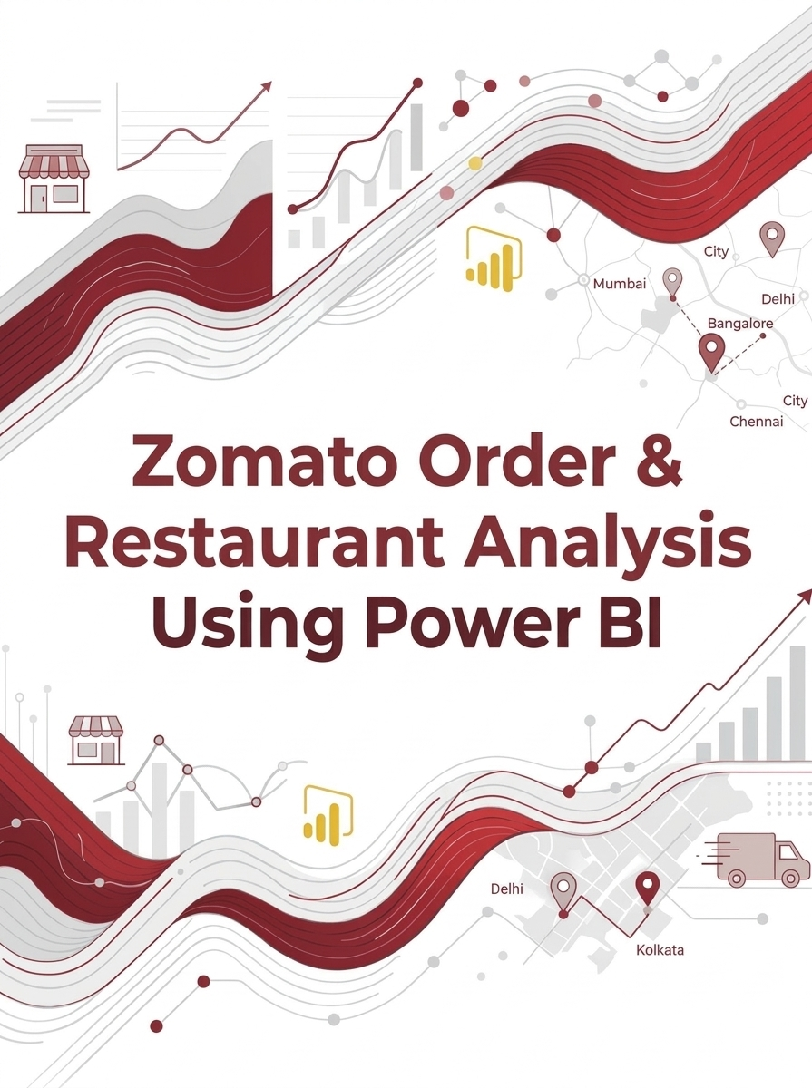
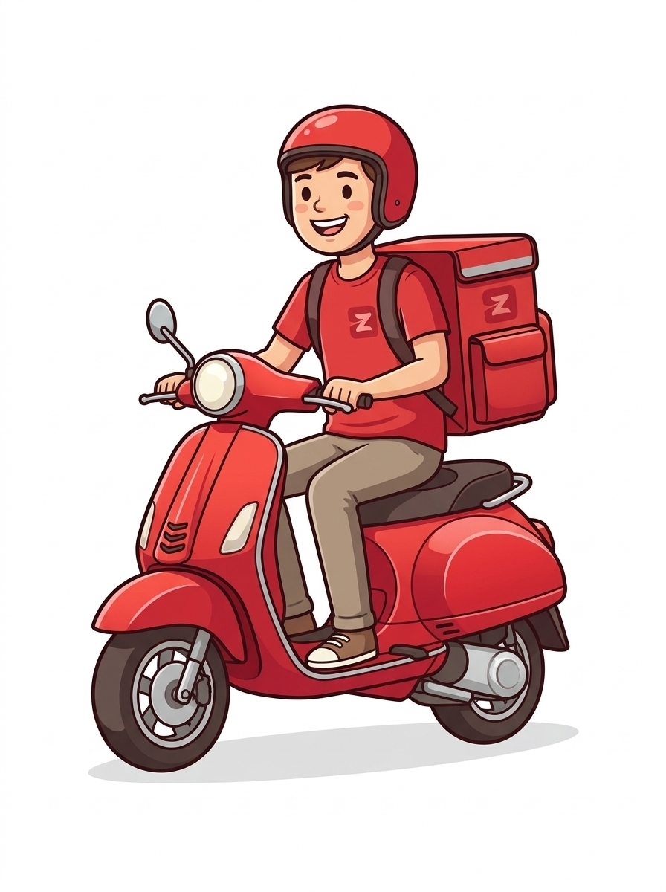
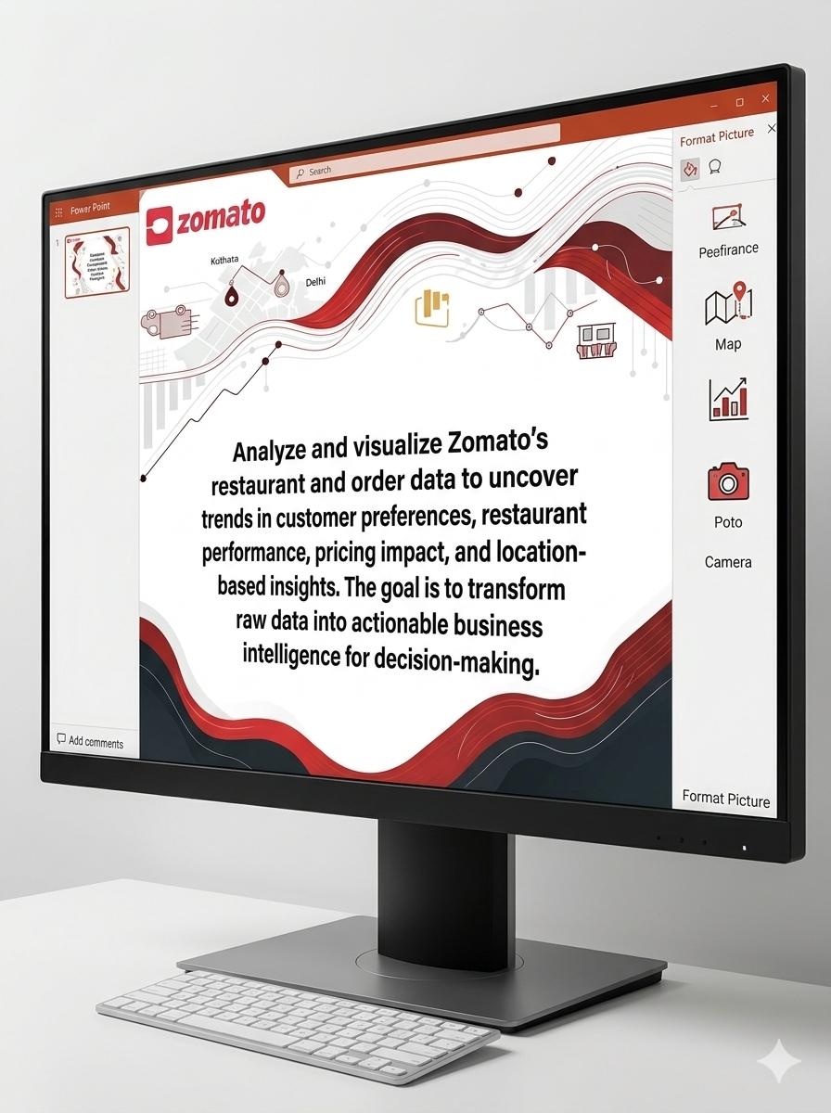

Slide 2
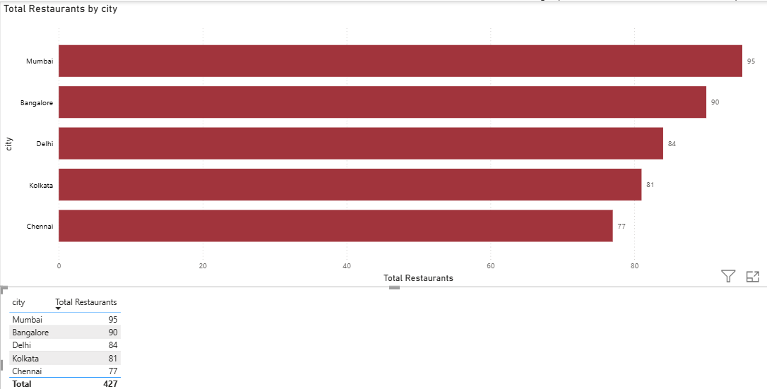
Task 1: Restaurant Distribution Across Cities
Key Insights
Market Lead: Mumbai holds the largest market share with 95 active restaurants.
Balanced Distribution: Restaurant counts are relatively uniform across all 5 metro regions, ranging tightly from 77 to 95.
Growth Opportunity: Chennai currently represents the smallest footprint (77 restaurants), serving as a potential target area for expansion.
Business Strategy Recommendations
Target Chennai Expansion: Launch focused campaigns to bridge gapes and capture untapped regional demand.
Optimize Top Markets: Scale Mumbai and Bangalore positions with localized offerings and loyalty programs.
Standardize Metro Playbooks: Implements a unified operational framework to streamline supply chains and boost profit.

Slide 3
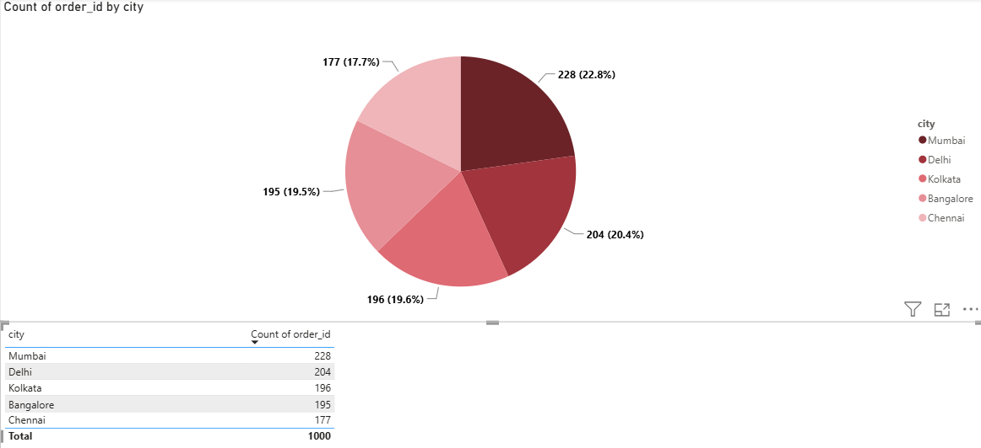
Task 2: City-Wise Order Contribution
Key Insights
Top Performers: Mumbai leads order volume at 22.8% (228 orders), followed closely by Delhi at 20.4% (204 orders).
Balanced Distribution: Orders are relatively evenly distributed across all five target cities, with Chennai holding the lowest share but still accounting for a solid 17.7% (177 orders).
Business Strategy Recommendations
Target High-Volume Hubs: Concentrate core marketing spend on Mumbai and Delhi to maximize returns.
Proportional Resource Allocation: Distribute fulfilment capacity and fleet resources relative to city order volume to minimize delivery times.
Expand Low-Penetration Markets: Run targeted acquisition campaigns in Chennai and Bangalore to balance the regional portfolio.

Slide 4
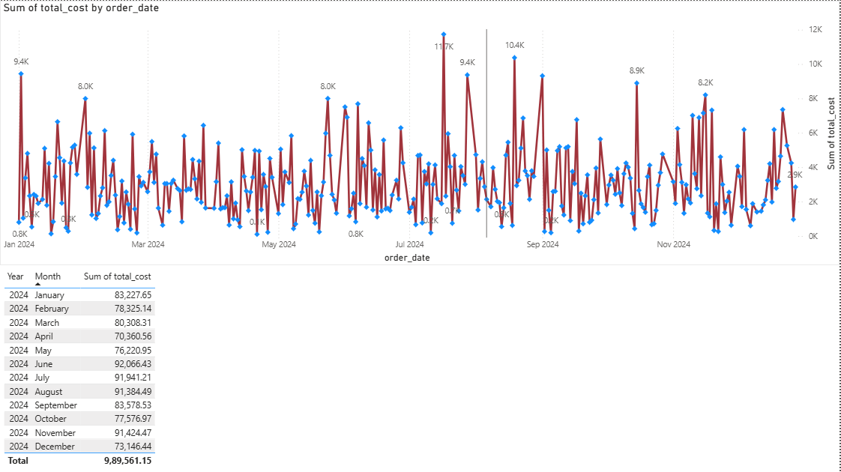
Task 3: Order Amount Trends Over Time
Key Insights
Mid-Year Surge: Costs Peak over 91k in June-August and spike again in November.
Low-Cost Baseline: Expenditure bottoms out in April (70.3k) and December (73.1k).
High Volatility: The line chart reveals massive, unpredictable daily cost fluctuations.
Business Strategy Recommendations
Mid-Year Cost Audits: Target June-August operations to control seasonal spending drivers.
Flat-Rate Contracts: Shift to fixed-price vendor agreements to mitigate expense spikes.
Logistics Optimization: Streamline supply chains to smooth out daily volatility.
Baseline Budgets: Use low-cost months to benchmark fixed versus variable expenses.

Slide 5
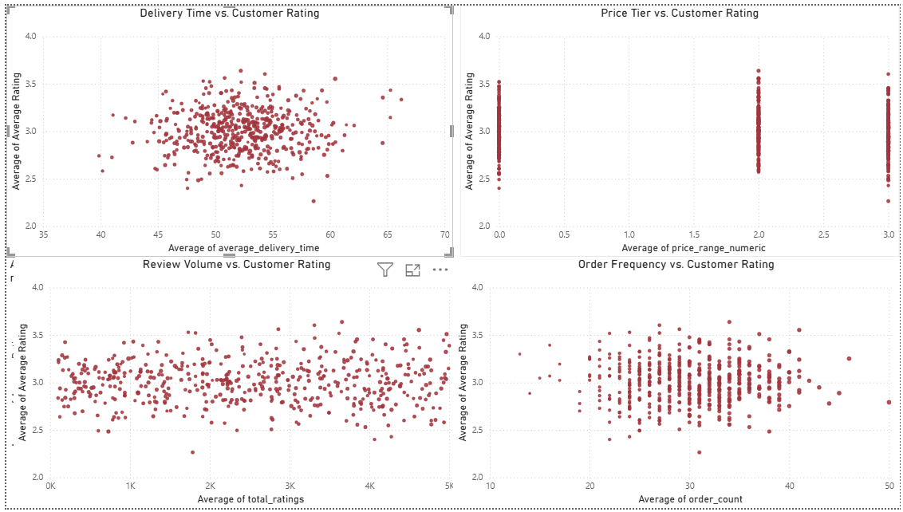
Task 4: Key Drivers of Customer Rating
Key Insights
Ratings Stay Flat: Customer ratings remain tightly clustered between 2.5 and 3.5 across all variables.
No Speed Impact: Faster delivery times (35 to 70 mins) do not noticeably boost customer ratings.
Price Has Law Effect: Higher price tiers show the same rating spread as lower price tiers.
Volume Does Not Equal Quantity: High order counts and review volumes do not guarantee higher ratings.
Business Strategy Recommendations
Audit Core Quality: Investigate food quality, packaging, and order accuracy since speed and pricing are not driving ratings.
Target Mid-Tier Performers: Focus improvement plans on restaurants stuck in the 2.5 to 3.5 rating band to push them above 4.0.
Refine Pricing Strategy: Introduce value bundles in higher price tiers to justify costs and improve customer satisfaction.
Collect Qualitative Feedback: Analyse written customer reviews to find the hidden pain points behind flat scores.

Slide 6
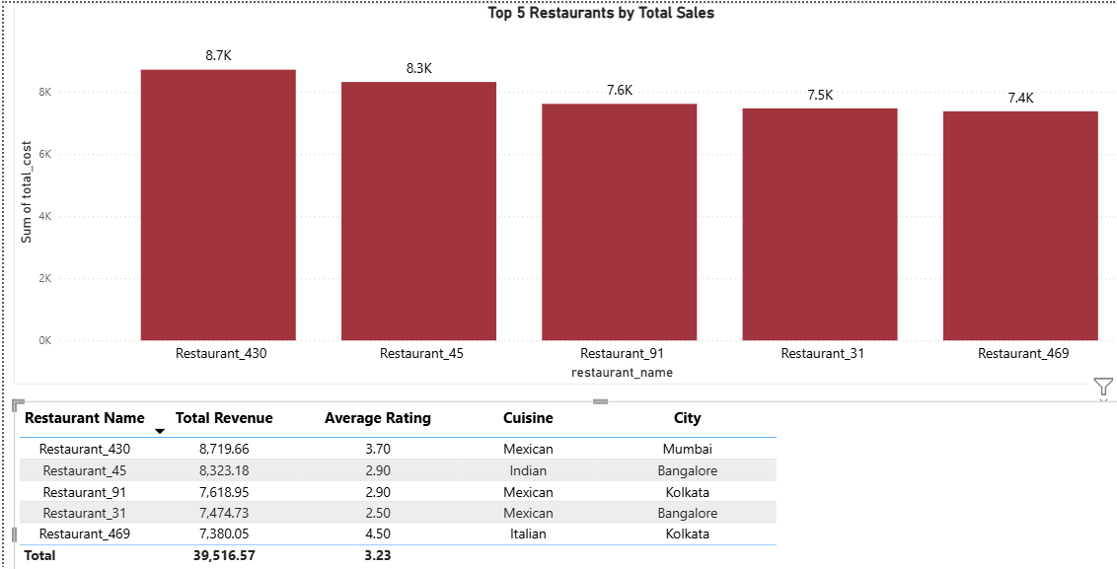
Task 5: Top 5 Restaurants by Total Revenue
The top 5 restaurants generate 39,516.57 in combined sales, led by Restaurant_430 at 8,719.66.
Key Insights
• Top Performers: Restaurant_430 (8,719.66) and Restaurant_45 (8,323.18) lead overall sales.
• Cuisine Dominance: Mexican food claims 3 of the top 5 spots, driving 23,813.34 in revenue.
• Metro Concentration: All 5 leaders operate in tier-1 cities, with Kolkata holding 2 spots.
• Rating Disconnect: Three top earners score below 3.00 (3.23 average), proving volume does not require high ratings.
• Quality Standout: Restaurant_469 pairs the highest rating (4.50) with strong sales (7,380.05).
Business Strategy Recommendations
• Audit Low-Rated Leaders. Fix quality issues at Restaurant_45 (2.90), Restaurant_91 (2.90), and Restaurant_31 (2.50).
• Expand Mexican Offerings. Onboard and promote more Mexican kitchens in Mumbai, Bangalore, and Kolkata.
• Replicate Success. Model operations after Restaurant_469 to balance high ratings with strong sales.

Slide 7
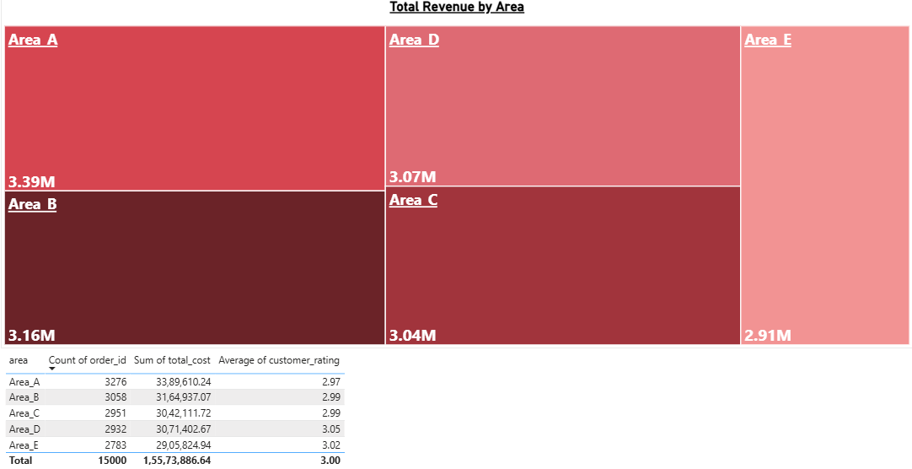
Task 6: Area-Wise Revenue & Customer Performance Analysis
Key Insights
• Top & Bottom Areas: Area A leads revenue at 3.39M (21.76% share), while Area E trails at 2.91M (18.66% share).
• Volume Drives Revenue: Higher order volume powers revenue growth, with Area A hitting 3,276 orders versus Area E's 2,783.
• Flat Order Values: Average order value stays nearly identical across all regions, ranging tightly between 1,031 and 1,048.
• Rating vs. Volume Gap: Highest-volume Area A holds the lowest rating (2.97), while lower-volume Area D leads satisfaction (3.05).
Business Strategy Recommendations
• Grow Low-Volume Areas: Run local promotions in Areas D and E to boost order frequency.
• Fix High-Volume Quality: Audit delivery speed and order accuracy in Area A to lift its 2.97 rating.
• Increase Basket Size: Launch bundle deals and free-delivery minimums to push order values above 1,038.

Slide 8
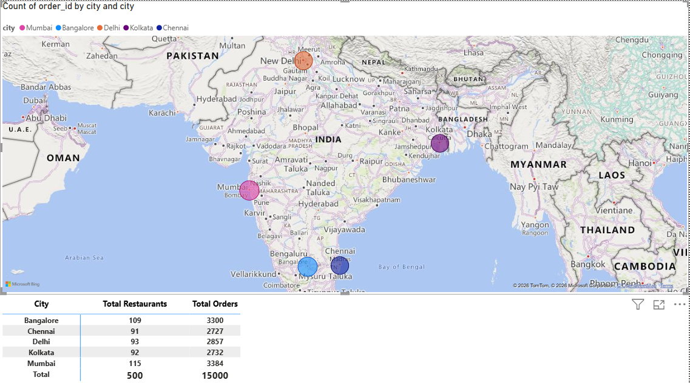
Task 7: City-Wise Order & Supply Analysis
Key Insights
• Top Hubs: Mumbai (3,384) and Bangalore (3,300) drive 44.6% of all 15,000 orders.
• Growth Markets: Kolkata (2,732) and Chennai (2,777) record the lowest order volumes.
• Balanced Supply: Orders average ~30 per restaurant across all cities (29.43–30.72), showing even supply scaling.
Business Recommendations
• Scale Core Hubs: Expand delivery fleet and peak-hour capacity in Mumbai and Bangalore.
• Stimulate Demand: Launch targeted promos in Kolkata and Chennai to boost order frequency.
• Steady Onboarding: Maintain current restaurant partner onboarding rates across all markets.

Slide 9
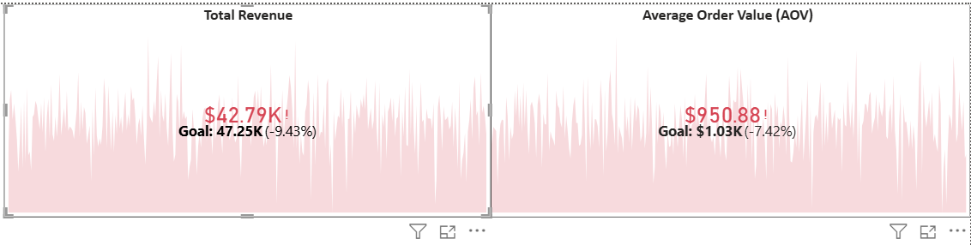
Task 8: Executive Revenue & AOV Performance Overview
Key Insights
• Revenue Shortfall: Total revenue is $42.79K, missing the $47.25K target by 9.43%.
• AOV Gap: Average Order Value stands at $950.88, falling 7.42% short of the $1.03K goal.
• Volatility: Both metrics show sharp fluctuations over time, ending on a downward dip.
Business Strategy Recommendations
• Boost Basket Size: Introduce product bundling and tiered volume discounts to lift AOV above $1.03K.
• Stabilize Sales: Launch targeted re-engagement campaigns during low-performing periods to smooth out revenue dips.
• Audit Pricing: Review discounting strategies and high-value product mix to close the 9.43% revenue gap.

Slide 10
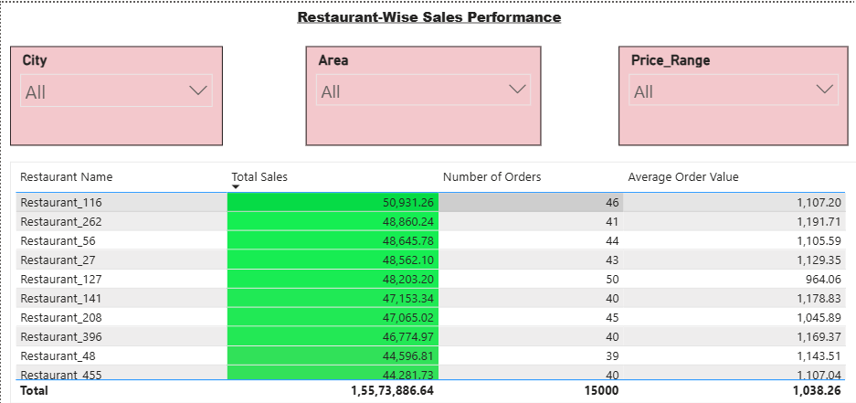
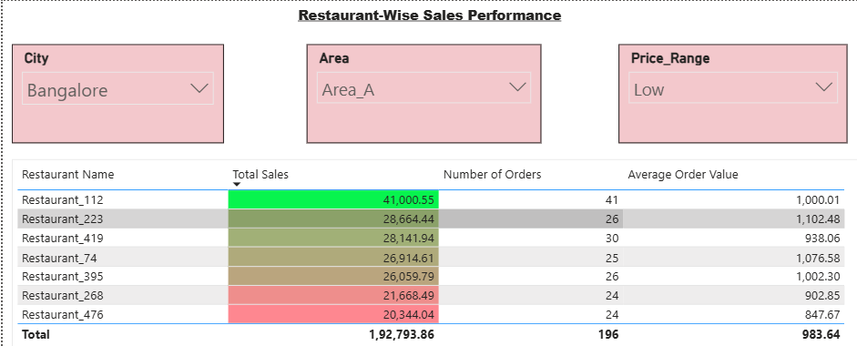
Task 9: Restaurant-Wise Sales Performance
This dashboard displays overall sales of ₹1,55,73,886.64 across 15,000 orders with an average order value of ₹1,038.26. Filtering for Bangalore, Area_A, and Low price narrows this to 7 restaurants generating ₹1,92,793.86 across 196 orders.
Key Insights
• Top Performers: Restaurant_116 leads overall sales (₹50,931.26), while Restaurant_112 tops the filtered view (₹41,000.55).
• Order Volume: Top overall outlets average 39–50 orders, while the filtered group averages 28 orders.
• Underperformers: Restaurant_476 ranks lowest in the filtered view with ₹20,344.04 in sales and an ₹847.67 AOV.
• AOV Consistency: The filtered AOV (₹983.64) stays close to the overall average (₹1,038.26).
Business Strategy Recommendations
• Replicate Success: Copy menu and promo strategies from Restaurant_116 and Restaurant_112 to other outlets.
• Boost Low Performers: Run targeted combos for red-flagged outlets like Restaurant_476 and Restaurant_268.
• Increase Basket Size: Add upselling prompts in Low price outlets to push AOV above ₹1,000.
• Localize Campaigns: Use slicers to focus marketing budgets on underperforming cities and areas.

Slide 11
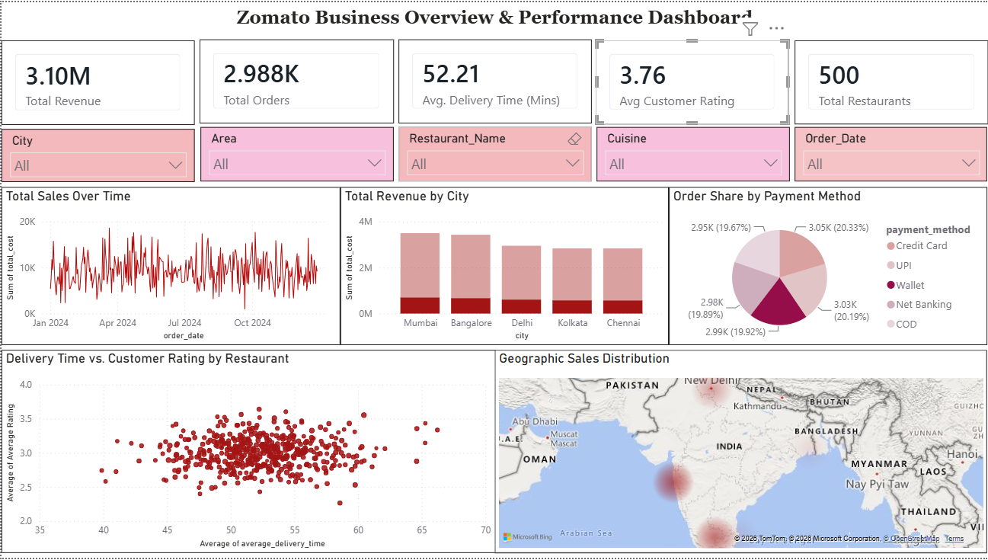
Task 10: Power BI Dashboard Combining All Visuals

Slide 12
Key Insights, Strategic Recommendations & Conclusion
Key Insights (2024)
• Revenue: Generated 3.10M from 2,988 orders across 500 restaurants.
• Top Markets: Mumbai leads revenue, followed closely by Bangalore and Delhi.
• Delivery & Ratings: 52.2 min average delivery time with a steady 3.76 rating.
• Payments: Order volume is split evenly (~20% each) across all 5 payment modes.
Strategic Actions (2026)
• Scale Top Hubs: Focus marketing and new restaurant onboarding in Mumbai and Bangalore.
• Speed Up Delivery: Optimize kitchen prep and routing to cut delivery times under 40 mins.
• Boost Quality: Audit restaurants rated below 3.5 to lift our overall platform average.
• Push Digital: Offer small UPI and Wallet cashbacks to shift users away from COD.

